Slide 1
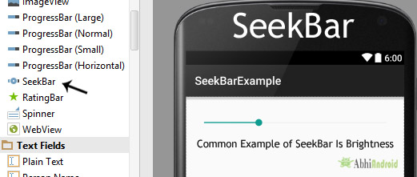
SEEKBar
In Android, SeekBar is an extension of ProgressBar that adds a draggable thumb, a user can touch the thumb and drag left or right to set the value for current progress.

Slide 2
Important three abstract Methods Used In SeekBar:
public void onProgressChanged (SeekBar seekBar, int progresValue, boolean from User) {…} – This listener method will be invoked if any change is made in the SeekBar.
public void onStartTrackingTouch(SeekBar seekBar) {…} – This listener method will be invoked at the start of user’s touch event. Whenever a user touch the thumb for dragging this method will automatically called.
3. public void onStopTrackingTouch(SeekBar seekBar) {…} – This listener method will be invoked at the end of user touch event. Whenever a user stop dragging the thump this method will be automatically called.
getMax() - get the maximum value of the SeekBar programmatically
getProgress() - get the current progress value from a Seekbar

Slide 3
Attributes of SeekBar In Android:
id: id attribute uniquely identify SeekBar.
max: max attribute in SeekBar define the maximum it can take. It must be an integer value like 10, 20, 100, 200 etc.
progress: progress is an attribute of SeekBar used to define the default progress value, between 0 and max. It must be an integer value.
Below we set the 200 max value and then set 50 default progress value.
<ProgressBar android:id="@+id/simpleProgressBar" android:layout_width="fill_parent" android:layout_height="wrap_content" android:max="100" style="@style/Widget.AppCompat.ProgressBar.Horizontal"
android:max="100“
android:progress="50"/><!--// 50 default progress value-->

Slide 4
4. progressDrawable: progress drawable attribute is used in Android to set the custom drawable xml for the progress mode of a seekbar. Progress drawable is used when we need to use a custom progress of a seekbar.
Below we set the custom gradient drawable for the progress mode of a Seekbar.
Step 1: Add this code in activity_main.xml or main.xml
<SeekBar android:id="@+id/simpleSeekBar" android:layout_width="fill_parent" android:layout_height="wrap_content" android:max="200" android:progress="50" android:progressDrawable="@drawable/custom_progress"/><!-- set custom progress drawable for the progress -->

Slide 5
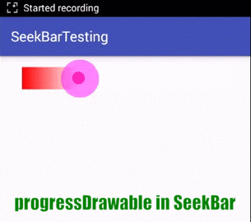
Step 2: Create a new drawable resource xml in drawable folder and name it custom_progress. Here add the below code which creates gradient effect in seekbar.
<?xml version="1.0" encoding="utf-8"?> <layer-list xmlns:android="http://schemas.android.com/apk/res/android" > <item> <shape> <gradient android:endColor="#fff" android:startColor="#f00" android:useLevel="true" /> </shape> </item> </layer-list>

Slide 6

5. ndeterminate: indeterminate is an attribute used in android to enable the indeterminate mode of a seekbar. In this mode a seekbar shows a cyclic animation without an indication of progress.
Below we set the indeterminate to true.
<SeekBar android:id="@+id/simpleSeekBar" android:layout_width="fill_parent" android:layout_height="wrap_content" android:max="200" android:indeterminate="true"/><!-- set custom progress drawable for the progress -->

Slide 7

6. background: background attribute of seekbar is used to set the background. We can set a color or a drawable in the background of a Seekbar. We can also set the background color in JAVA class.
Below we set the green color for the background of a Seek bar.
<SeekBar android:id="@+id/simpleSeekBar" android:layout_width="fill_parent" android:layout_height="wrap_content" android:max="200" android:indeterminate="true" android:background="#0F0"/><!-- set green color in the background of seek bar-->

Slide 8
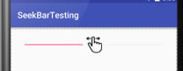
7. thumb: thumb attribute is used in seekbar to draw a thumb on a seekbar. We can use an image or a drawable for the thumb.
Below is an example code in which we set a drawable icon for the thumb of the seekbar.
<SeekBar android:id="@+id/simpleSeekBar" android:layout_width="fill_parent" android:layout_height="wrap_content" android:max="200" android:progress="100" android:thumb="@drawable/thumb"/><!-- set a thumb drawable icon for the seek bar-->

Slide 9
Intents
Android uses Intent for communicating between the components of an Application and also from one application to another application.
Intent are the objects which is used in android for passing the information among Activities in an Application and from one app to another also. Intent are used for communicating between the Application components and it also provides the connectivity between two apps.
For example: Intent facilitate you to redirect your activity to another activity on occurrence of any event. By calling, startActivity() you can perform this task.
Intent intent = new Intent(getApplicationContext(), SecondActivity.class); startActivity(intent);

Slide 10
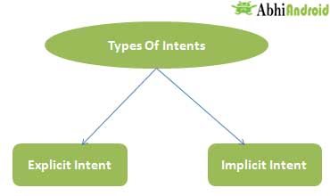
Types of Intents
Intent are of two types: Explicit Intent and Implicit Intent
Explicit Intent:
Explicit Intents are used to connect the application internally.
In Explicit we use the name of component which will be affected by Intent. For Example: If we know class name then we can navigate the app from One Activity to another activity using Intent. In the similar way we can start a service to download a file in background process.
Intent intent = new Intent(getApplicationContext(), SecondActivity.class); startActivity(intent);

Slide 11
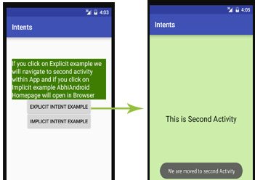
Explicit Intent example

Slide 12
Implicit Intent
In Implicit Intents we do need to specify the name of the component. We just specify the Action which has to be performed and further this action is handled by the component of another application.
The basic example of implicit Intent is to open any web page
Let’s take an example to understand Implicit Intents more clearly. We have to open a website using intent in your application. See the code snippet given below
Intent intentObj = new Intent(Intent.ACTION_VIEW); intentObj.setData(Uri.parse("https://www.abhiandroid.com")); startActivity(intentObj);

Slide 13
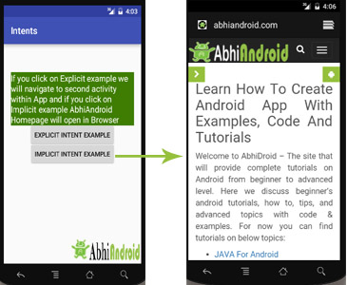
Implicit Intent example

Slide 14
Intent Uses In Android:
Android uses Intents for facilitating communication between its components like Activities, Services and Broadcast Receivers.
Intent for an Activity:
Every screen in Android application represents an activity. To start a new activity you need to pass an Intent object to startActivity() method. This Intent object helps to start a new activity and passing data to the second activity.
Intent for Services:
Services work in background of an Android application and it does not require any user Interface. Intents could be used to start a Service that performs one-time task(for example: Downloading some file) or for starting a Service you need to pass Intent to startService() method.
Intent for Broadcast Receivers:
There are various message that an app receives, these messages are called as Broadcast Receivers. (For example, a broadcast message could be initiated to intimate that the file downloading is completed and ready to use). Android system initiates some broadcast message on several events, such as System Reboot, Low Battery warning message etc.

